Slide 2
Objectives
Identify the most important points of the book Wintergirls, · Connect the most important topics with their previous knowledge about anorexia and bulimia. · Use vocabulary correctly to debate the topic giving opinion and considering different perspectives. · Write reader response journals answering the questions online (Facebook Page or Weebly blog page) § What do you notice? § What do you question? § What do you feel? § What do you relate to? · Produce videos about their analysis of the book. · Create profiles for the characters and interact with others characters.

Slide 3
Technological Objectives
Students will produce Facebook or Fakebook pages about the characters,
Students should interact somehow in these social medias.
Students create videos at the end of the Unit.
Students interact with other students from other countries or even the writers.

Slide 4
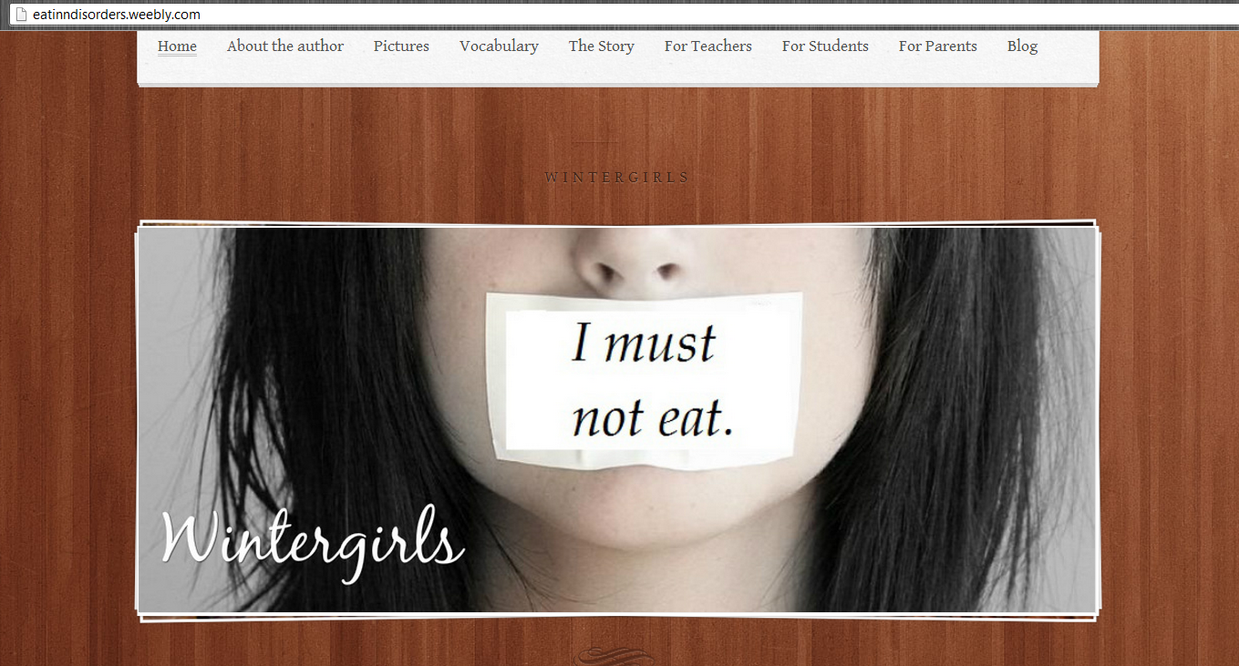

Slide 5
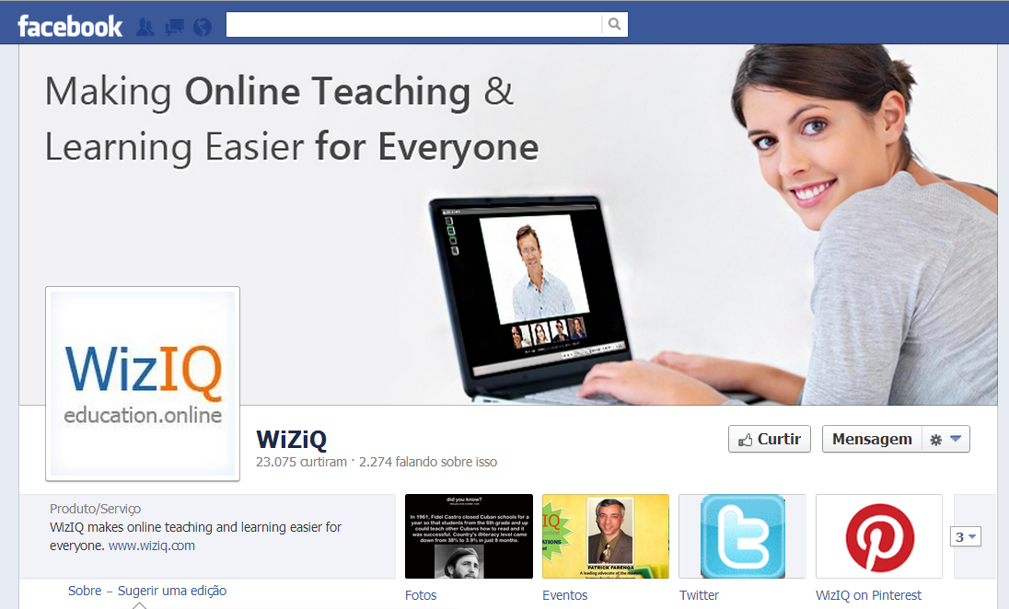

Slide 6
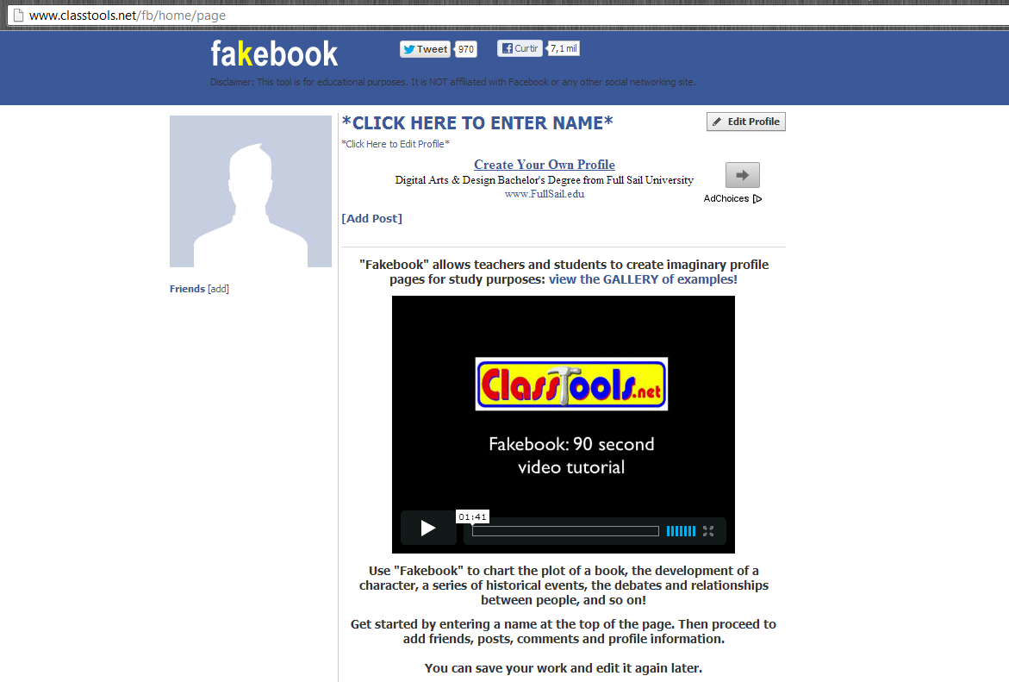

Slide 8
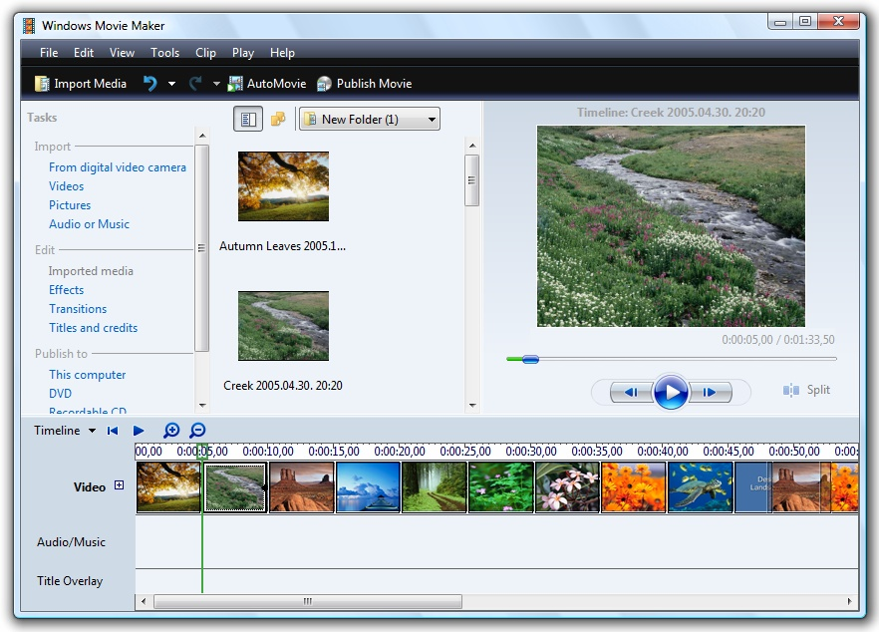

Slide 10
